Slide 1
Microsoft Teams User Group Berlin
17. Februar 2022
Meetup #17

Slide 2
Danke!

Slide 3
Agenda
18:00 - 18:15 | Landing Zone
18:15 - 19:15 | Talk 1 – OneNote and Microsoft Teams, Smarter Notetaking Together Heather Severino (@HeatherSeverino)
19:15 - 19:45 | Microsoft Teams Neuigkeiten Thomas Stensitzki (@stensitzki)
19:45 - ? | Fragen und Antworten rund um Microsoft Teams Organisatorisches
Dieses Meeting wird aufgezeichnet und online bereitgestellt. This meeting will be recorded and made available online.

Slide 4
OneNote and Microsoft Teams, Smarter Notetaking Together
Heather Severino @HeatherSeverino

Slide 5
Pause ☺
→ Um 19:30 Uhr geht es weiter

Slide 6
Neues in Microsoft Teams Ankündigungen & Rollouts
Updates
Meetup #17 Thomas Stensitzki

Slide 7
Neuigkeiten in Microsoft Teams
Improved Teams Guest User Usability
Expanded reactions in Microsoft Teams
Updated companion mode for iOS users
Connected Templates
Live Captions in all available languages and CART Captions on Teams Meetings on Web
Microsoft Viva: Praise History in Microsoft Viva Insights Weitere Informationen
Automatically Detect Music

Slide 8
Improved Teams Guest User Usability
Guest users can decline a pending guest invitation within Teams app
Decline → Teams Tenant List will not show the tenant with the pending invitation and in the Account Management tab
Guest users can initiate leaving an org
Leave Org → User will be guided on how to leave a tenant from Teams and Azure Portal
Guest users can manage guest tenant list
Hide/Show in Settings → The tenant will be shown (or hidden) in the Menu under the tenant list

Slide 9
Neuigkeiten in Microsoft Teams
Improved Teams Guest User Usability
Expanded reactions in Microsoft Teams
Updated companion mode for iOS users
Connected Templates
Live Captions in all available languages and CART Captions on Teams Meetings on Web
Microsoft Viva: Praise History in Microsoft Viva Insights Weitere Informationen
Automatically Detect Music

Slide 10
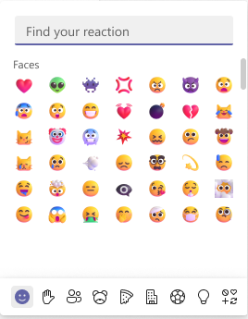
Expanded reactions in Microsoft Teams
→ Ab Mitte Mai
Notes:
Standard: will begin rolling out in mid-May (previously early March) and expect to complete rollout by early June (previously late March).
GCC: will begin rolling out in mid-May (previously early March) and expect to complete rollout by early June (previously late March).
GCC-H: will begin rolling this out in mid-June (previously early April) and expect to complete rollout by late June (previously late April).
DOD: will begin rolling this out in mid-June (previously early April) and expect to complete rollout by late June (previously late April).

Slide 11
Neuigkeiten in Microsoft Teams
Improved Teams Guest User Usability
Expanded reactions in Microsoft Teams
Updated companion mode for iOS users
Connected Templates
Live Captions in all available languages and CART Captions on Teams Meetings on Web
Microsoft Viva: Praise History in Microsoft Viva Insights Weitere Informationen
Automatically Detect Music

Slide 12
Neuigkeiten in Microsoft Teams
Improved Teams Guest User Usability
Expanded reactions in Microsoft Teams
Updated companion mode for iOS users
Connected Templates
Live Captions in all available languages and CART Captions on Teams Meetings on Web
Microsoft Viva: Praise History in Microsoft Viva Insights Weitere Informationen
Automatically Detect Music

Slide 13
Connected Templates
Microsoft Team Templates allow administrators to easily deploy consistent teams across their organization using predefined or customized team templates across their organization.
SharePoint templates offer a straightforward way for admins to build sites with pre-populated pages, page templates, news post templates, and web parts that can be customized to fit the needs of their organization.
Notes:
https://www.microsoft.com/microsoft-365/roadmap?filters=&searchterms=84724

Slide 14
Neuigkeiten in Microsoft Teams
Improved Teams Guest User Usability
Expanded reactions in Microsoft Teams
Updated companion mode for iOS users
Connected Templates
Live Captions in all available languages and CART Captions on Teams Meetings on Web
Microsoft Viva: Praise History in Microsoft Viva Insights Weitere Informationen
Automatically Detect Music

Slide 15
Live Captions in all available languages and CART Captions on Teams Meetings on Web
Live captions for web
→ Mitte Februar
CART captions for web
→ Mitte April
Weitere Informationen zu CART
Notes:
Communication access real-time translation (CART)

Slide 16
Neuigkeiten in Microsoft Teams
Improved Teams Guest User Usability
Expanded reactions in Microsoft Teams
Updated companion mode for iOS users
Connected Templates
Live Captions in all available languages and CART Captions on Teams Meetings on Web
Microsoft Viva: Praise History in Microsoft Viva Insights Weitere Informationen
Automatically Detect Music

Slide 17
Neuigkeiten in Microsoft Teams
Improved Teams Guest User Usability
Expanded reactions in Microsoft Teams
Updated companion mode for iOS users
Connected Templates
Live Captions in all available languages and CART Captions on Teams Meetings on Web
Microsoft Viva: Praise History in Microsoft Viva Insights Weitere Informationen
Automatically Detect Music

Slide 18

Automatically Detect Music
ML-based noise suppression enabled by default for
ML-based noise suppression considers any non-speech signal picked up by the microphone as noise which should be suppressed
Avoid suppressing music
Enable the new High fidelity music mode
Built-In ML-based music detector → Notification

Slide 19
Neuigkeiten in Microsoft Teams
Transcription in 1:1 VOIP Calls (→ Januar)
Microsoft Teams: Chat density
Mute Notifications During Meetings
Microsoft Forms new App "Polls" in Teams
Pin a chat message
Walkie Talkie on iOS General Availability
Hide your own video in Teams meetings

Slide 20
Neuigkeiten in Microsoft Teams
Transcription in 1:1 VOIP Calls (→ Januar)
Microsoft Teams: Chat density
Mute Notifications During Meetings
Microsoft Forms new App "Polls" in Teams
Pin a chat message
Walkie Talkie on iOS General Availability
Hide your own video in Teams meetings

Slide 21
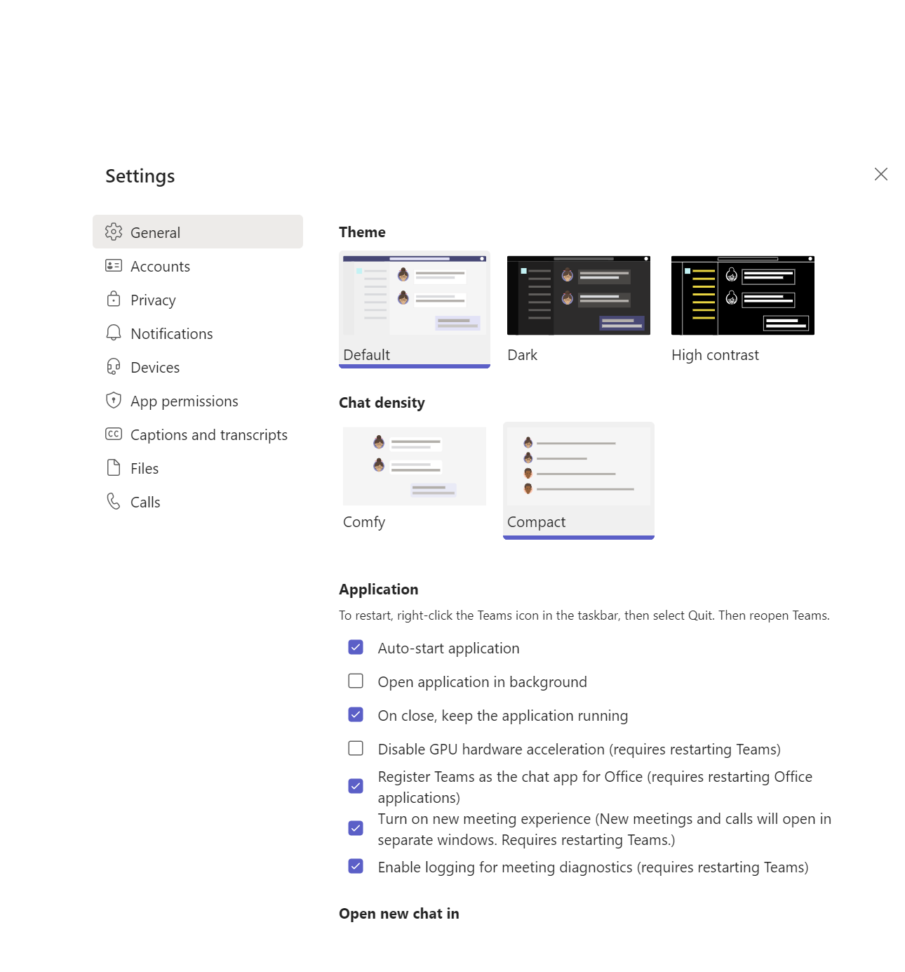
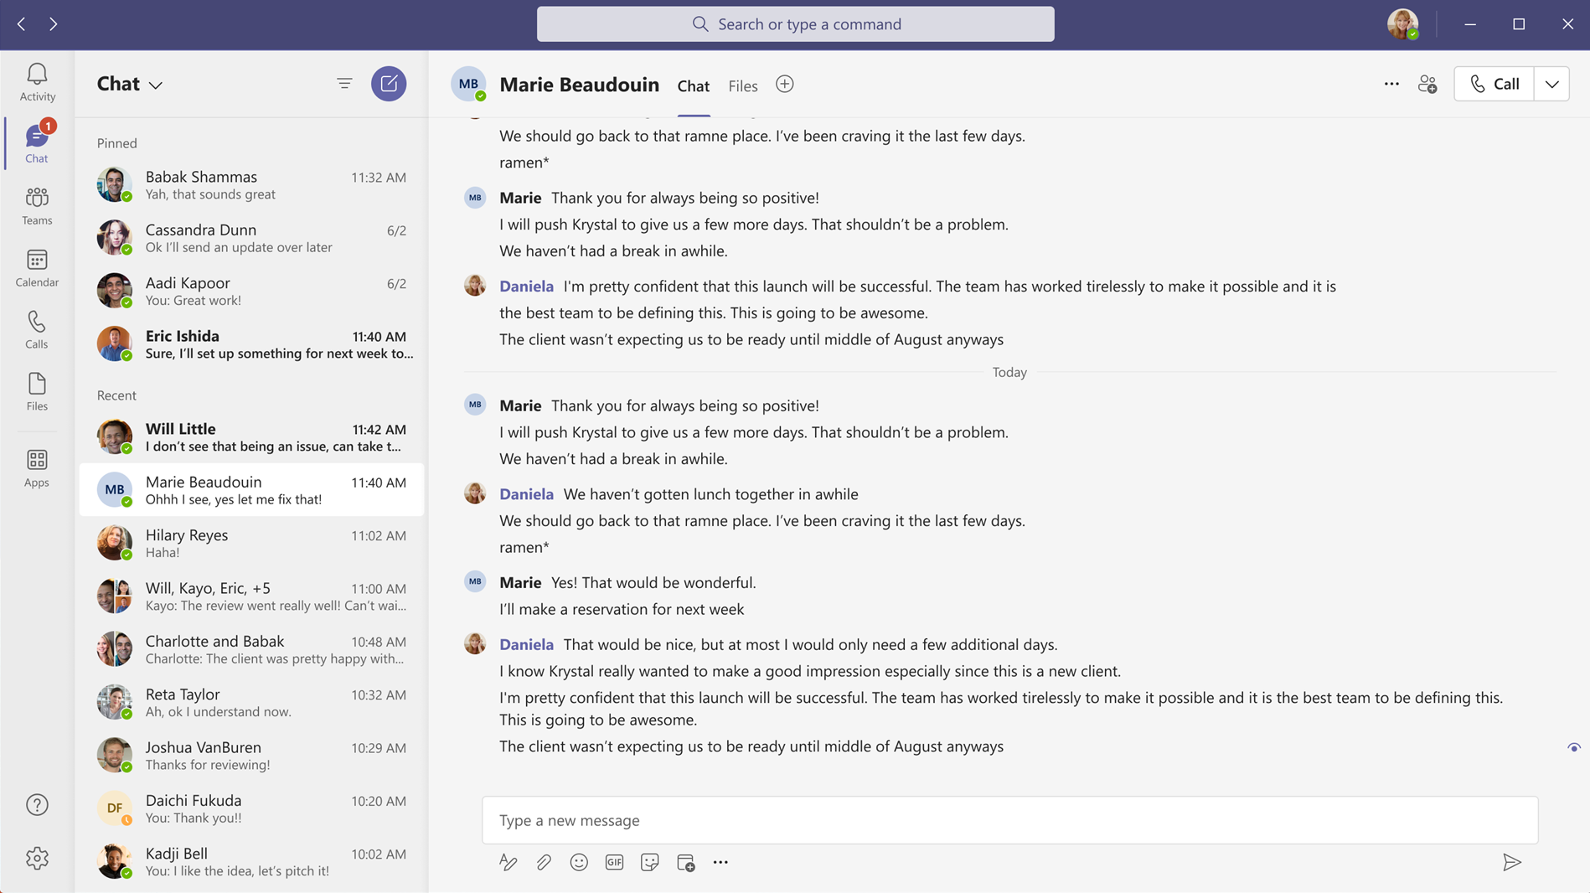
Microsoft Teams: Chat density
Notes:
Customize the number of chat messages you see on the screen. Use the compact setting to fit 50 percent more messages on the screen. Comfortable setting keeps the chat display as it is in Teams today.
This will be rolling out on Teams desktop.

Slide 22
Neuigkeiten in Microsoft Teams
Transcription in 1:1 VOIP Calls (→ Januar)
Microsoft Teams: Chat density
Mute Notifications During Meetings
Microsoft Forms new App "Polls" in Teams
Pin a chat message
Walkie Talkie on iOS General Availability
Hide your own video in Teams meetings

Slide 23
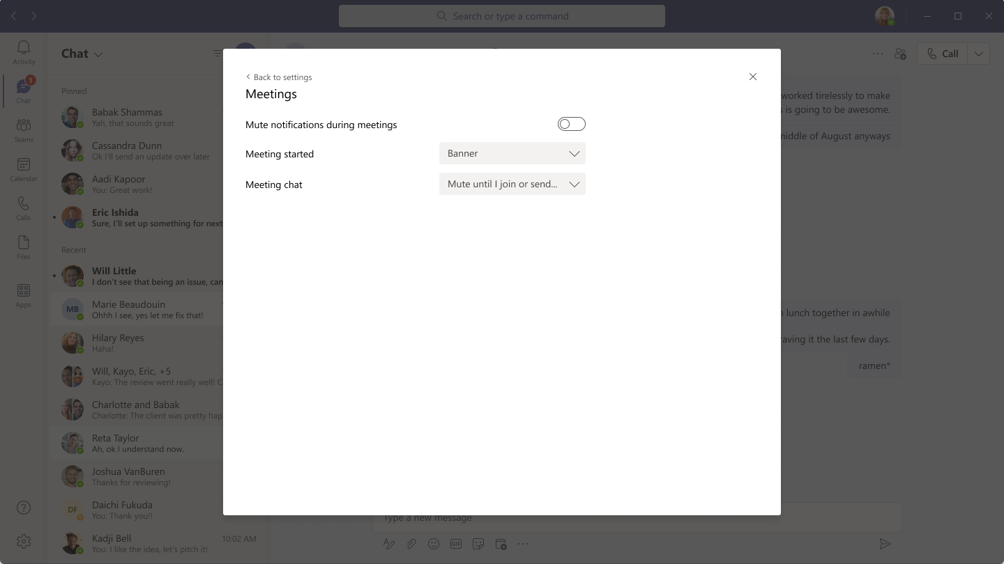
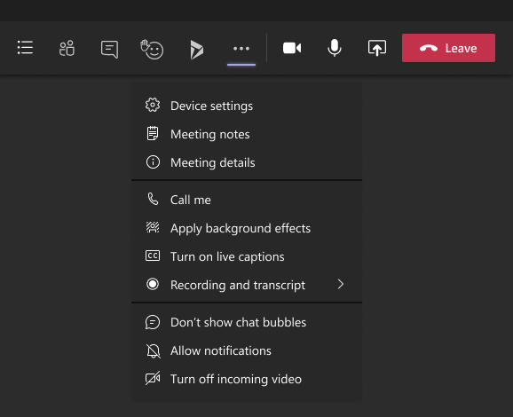
Mute Notifications During Meetings
Nur für Desktop
Allgemein gültige Einstellung für alle Besprechungen
Individuell je Besprechung
Im Web-Client nicht verfügbar

Slide 24
Neuigkeiten in Microsoft Teams
Transcription in 1:1 VOIP Calls (→ Januar)
Microsoft Teams: Chat density
Mute Notifications During Meetings
Microsoft Forms new App "Polls" in Teams
Pin a chat message
Walkie Talkie on iOS General Availability
Hide your own video in Teams meetings

Slide 25
Microsoft Forms new App "Polls" in Teams
The new Microsoft Forms App "Polls" will have the same functionality, same service, and there will be no need for data migration.
For the previous polls that were created in the original App "Forms", these polls will not be lost. Poll owners can still view them in the new App "Polls" portal in Teams OR view it in the Forms web portal page (http://forms.office.com/)
The original App "Forms" polling capability will be retired in Teams meeting and Teams chat. Original App "Forms" survey capability in Teams channel Tab is not impacted.
Notes:
The original "Forms" app will be retired from Teams meetings in March (previously January), and then will be retired from Teams chat in April (previously February). Once retired from meetings/chat the “Forms” app will only be available in the Teams channel tab to provide Survey capabilities.

Slide 26
Neuigkeiten in Microsoft Teams
Transcription in 1:1 VOIP Calls (→ Januar)
Microsoft Teams: Chat density
Mute Notifications During Meetings
Microsoft Forms new App "Polls" in Teams
Pin a chat message
Walkie Talkie on iOS General Availability
Hide your own video in Teams meetings

Slide 27
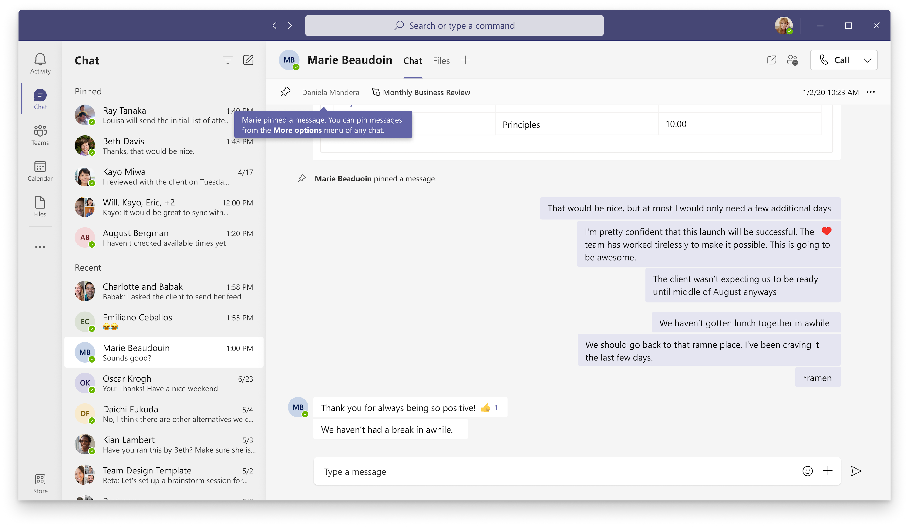
Pin a chat message
Notes:
Any member of a chat will be able to pin/unpin any specific chat message to the top of the chat header, for all members to see. Users can click on the pinned message to go to the original message in the chat thread. Currently, only a single message can be pinned at a time.

Slide 28
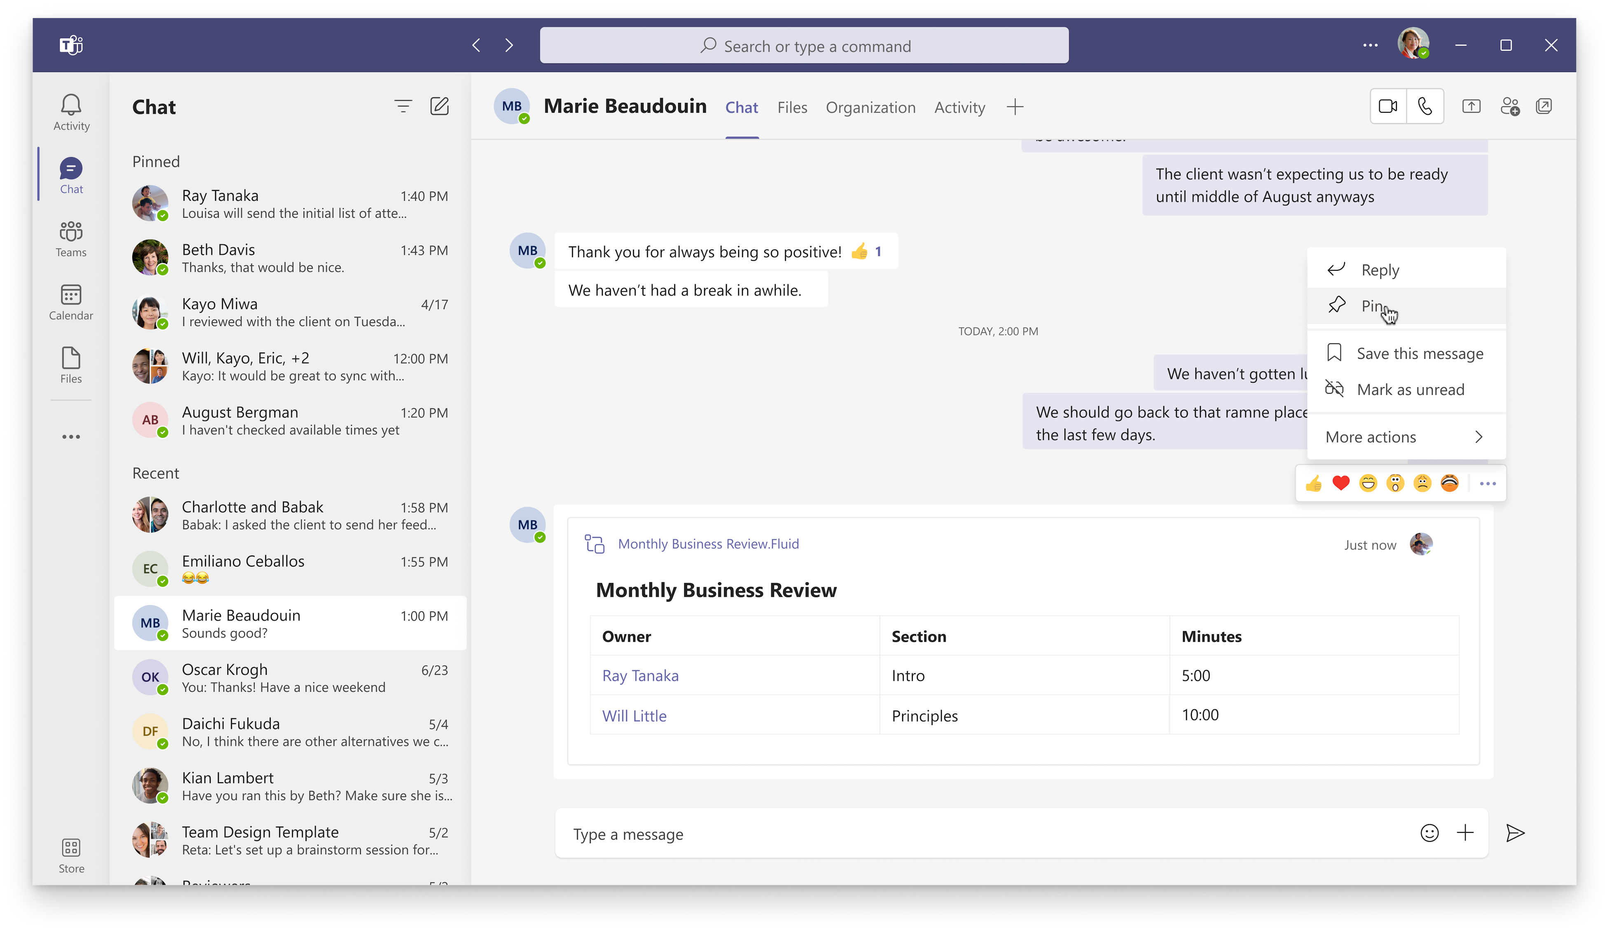
Pin a chat message
Notes:
Any member of a chat will be able to pin/unpin any specific chat message to the top of the chat header, for all members to see. Users can click on the pinned message to go to the original message in the chat thread. Currently, only a single message can be pinned at a time.

Slide 29
Neuigkeiten in Microsoft Teams
Transcription in 1:1 VOIP Calls (→ Januar)
Microsoft Teams: Chat density
Mute Notifications During Meetings
Microsoft Forms new App "Polls" in Teams
Pin a chat message
Walkie Talkie on iOS General Availability
Hide your own video in Teams meetings

Slide 30
Walkie Talkie on iOS General Availability

Slide 31
Neuigkeiten in Microsoft Teams
Transcription in 1:1 VOIP Calls (→ Januar)
Microsoft Teams: Chat density
Mute Notifications During Meetings
Microsoft Forms new App "Polls" in Teams
Pin a chat message
Walkie Talkie on iOS General Availability
Hide your own video in Teams meetings

Slide 32
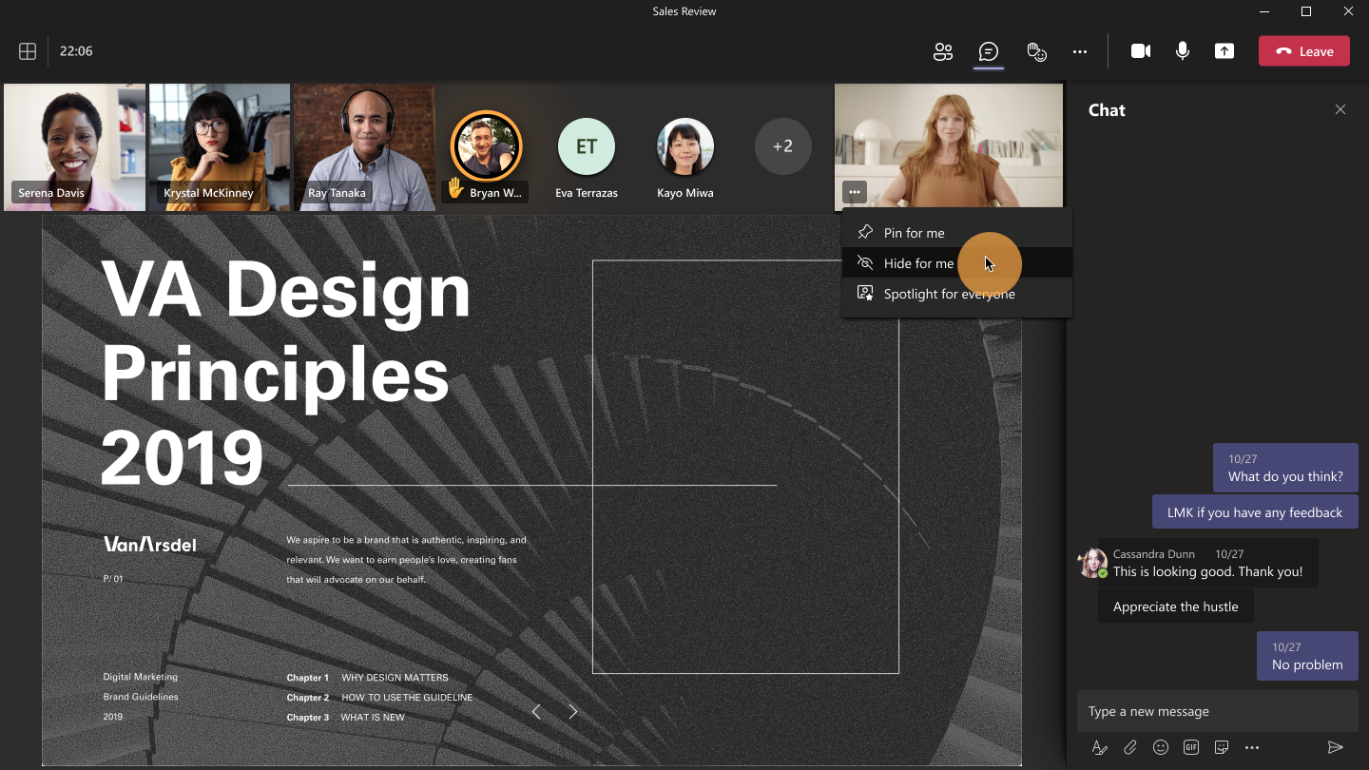
Hide your own video in Teams meetings

Slide 33
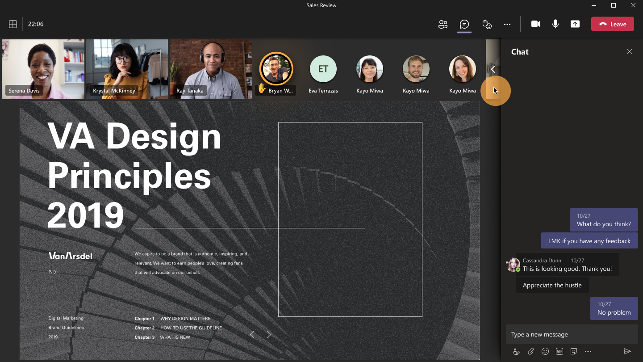
Hide your own video in Teams meetings

Slide 34
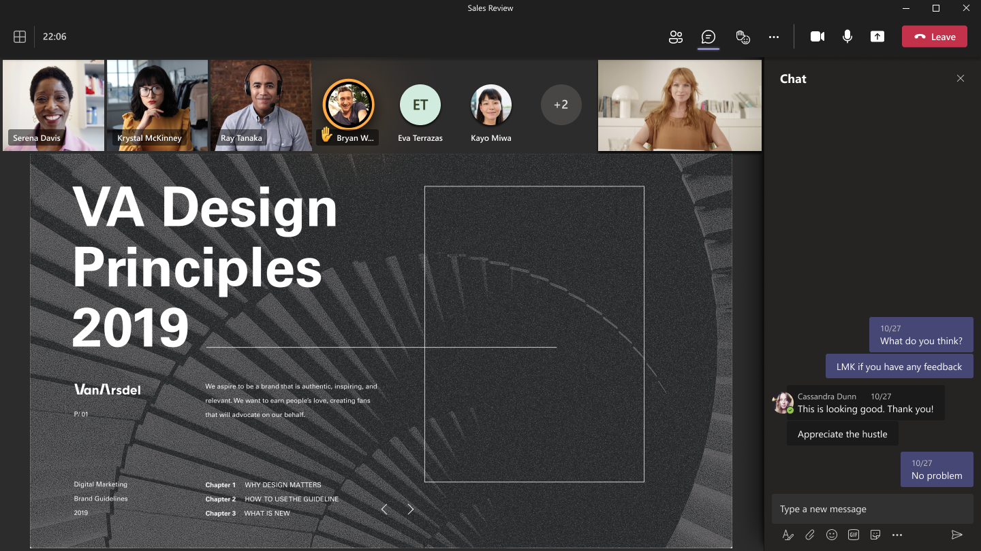
Hide your own video in Teams meetings
Notes:
Go to the Me video menu - you can find it in the Me box, clicking on ...;
Select Hide for me. Your Me box is going to roll either vertically or horizontally depending on the position of your gallery. If you no longer wish to be hidden, select Unhide for me by clicking on the arrow available in the collapsed state.
You can easily hide or unhide yourself when clicking on the menu next to your name in roster too.

Slide 35
Neuigkeiten in Microsoft Teams für Admins
New Teams Phone Devices Update (February 2022 Edition)
Admin notifications for Custom app submissions Weitere Informationen
New Share to Stage APIs in Teams SDK Weitere Informationen
Teams app setup policy group assignment Weitere Informationen
Teams Meeting Recordings Auto-Expiration in OneDrive and SharePoint Weitere Informationen
Records Management–Announcing public preview of adaptive policy scopes for retention and label policies

Slide 36
New Teams Phone Devices Update
Teams App Version: 1449/1.0.94.2022020202
Teams phones with touch screen will support for instant push to talk communication via our new Walkie-Talkie feature.
Teams phones with touch screen will support an improved user interface for multiple incoming/held calls and parked calls.
Teams conference phones in portrait mode will support an updated user interface, aligned with our meeting solutions.
Bug fixes addressing Teams android devices showing as offline in Teams admin center.
Performance enhancements addressing screen navigation and sidecar issues
Bug fix to address held calls when user replaces handset to cradle.
Known issues with ongoing calls when Walkie-Talkie calls interrupt.

Slide 37
Neuigkeiten in Microsoft Teams für Admins
New Teams Phone Devices Update (February 2022 Edition)
Admin notifications for Custom app submissions Weitere Informationen
New Share to Stage APIs in Teams SDK Weitere Informationen
Teams app setup policy group assignment Weitere Informationen
Teams Meeting Recordings Auto-Expiration in OneDrive and SharePoint Weitere Informationen
Records Management–Announcing public preview of adaptive policy scopes for retention and label policies

Slide 38
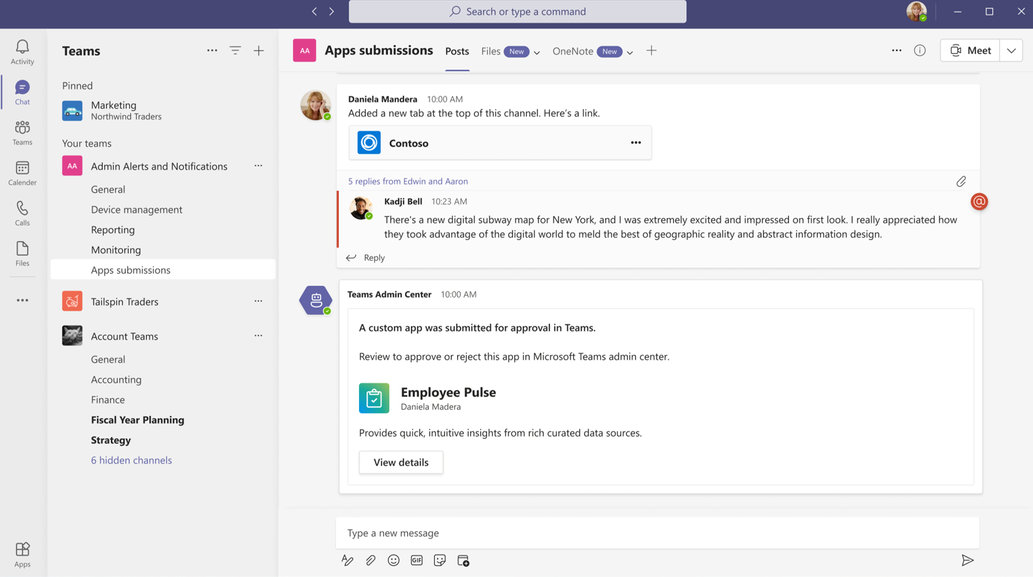
Admin notifications for Custom app submissions
Notes:
This feature is now available.

Slide 39
Neuigkeiten in Microsoft Teams für Admins
New Teams Phone Devices Update (February 2022 Edition)
Admin notifications for Custom app submissions Weitere Informationen
New Share to Stage APIs in Teams SDK Weitere Informationen
Teams app setup policy group assignment Weitere Informationen
Teams Meeting Recordings Auto-Expiration in OneDrive and SharePoint Weitere Informationen
Records Management–Announcing public preview of adaptive policy scopes for retention and label policies
Notes:
If you aren’t using the Teams Client SDK, you can safely disregard this message.

Slide 40
Neuigkeiten in Microsoft Teams für Admins
New Teams Phone Devices Update (February 2022 Edition)
Admin notifications for Custom app submissions Weitere Informationen
New Share to Stage APIs in Teams SDK Weitere Informationen
Teams app setup policy group assignment Weitere Informationen
Teams Meeting Recordings Auto-Expiration in OneDrive and SharePoint Weitere Informationen
Records Management–Announcing public preview of adaptive policy scopes for retention and label policies

Slide 41
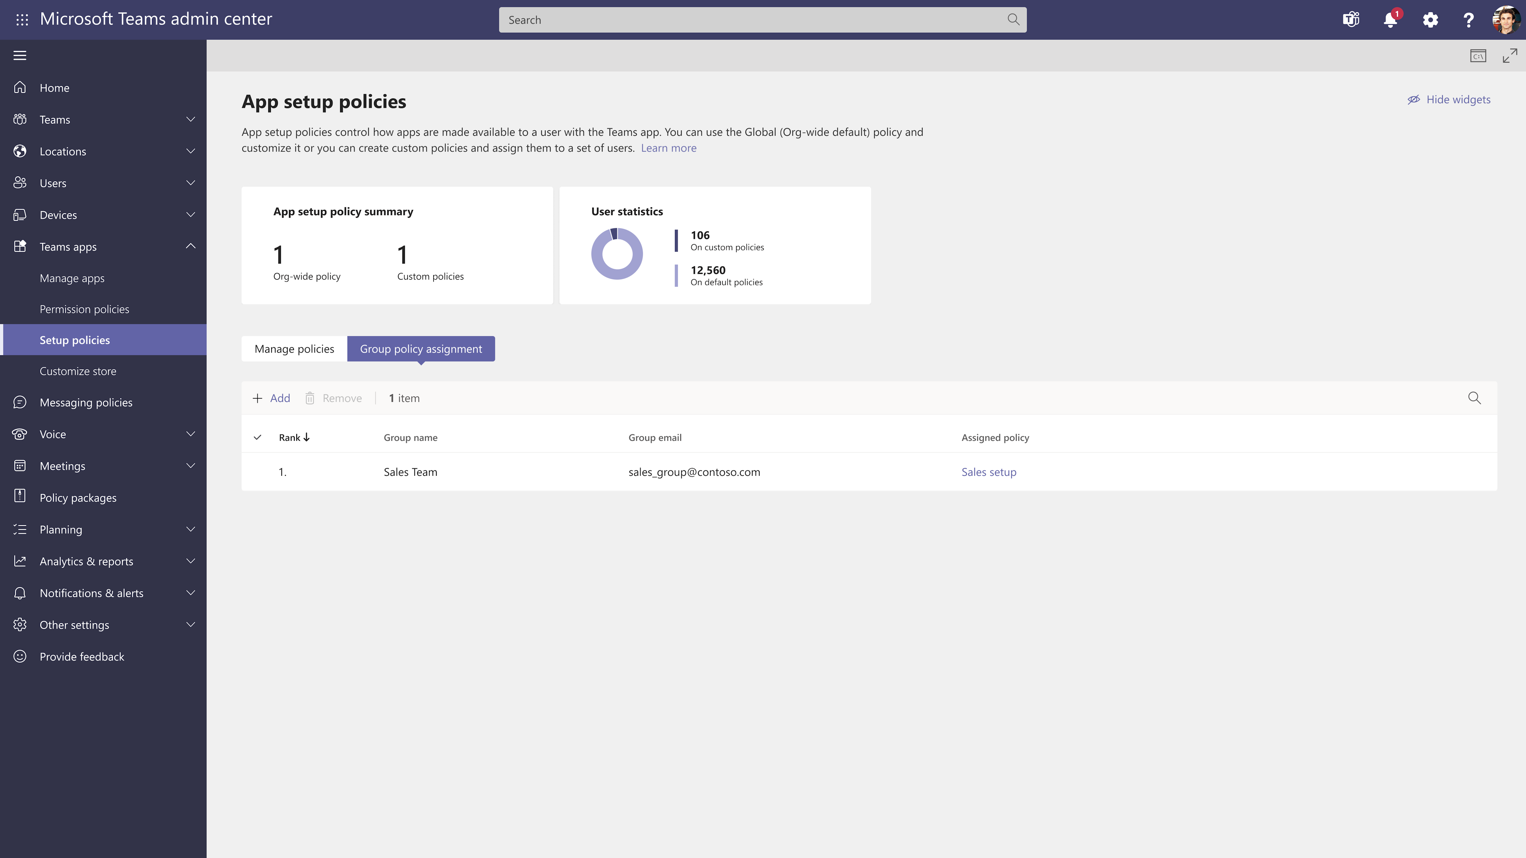
Teams app setup policy group assignment

Slide 42
Neuigkeiten in Microsoft Teams für Admins
New Teams Phone Devices Update (February 2022 Edition)
Admin notifications for Custom app submissions Weitere Informationen
New Share to Stage APIs in Teams SDK Weitere Informationen
Teams app setup policy group assignment Weitere Informationen
Teams Meeting Recordings Auto-Expiration in OneDrive and SharePoint Weitere Informationen
Records Management–Announcing public preview of adaptive policy scopes for retention and label policies

Slide 43
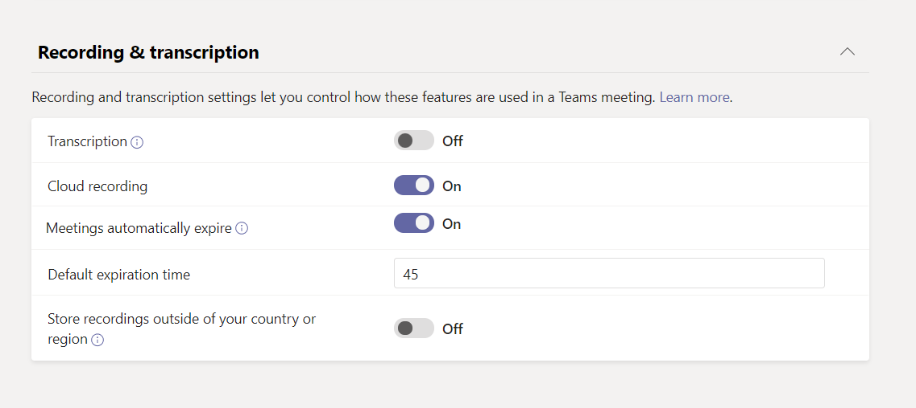
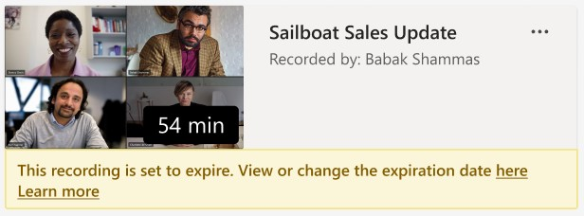
Teams Meeting Recordings Auto-Expiration in OneDrive and SharePoint
This feature does not impact meeting recordings stored in Microsoft Stream (classic Stream) but will affect recordings stored in the new Stream (built on OneDrive and SharePoint).
This feature is only available for Teams meeting recordings created by the Teams service in OneDrive and SharePoint. It is not available for other file types in OneDrive and SharePoint.
Set-CsTeamsMeetingPolicy -Identity Global -NewMeetingRecordingExpirationDays 30
→ 25. März 2022

Slide 44
Neuigkeiten in Microsoft Teams für Admins
New Teams Phone Devices Update (February 2022 Edition)
Admin notifications for Custom app submissions Weitere Informationen
New Share to Stage APIs in Teams SDK Weitere Informationen
Teams app setup policy group assignment Weitere Informationen
Teams Meeting Recordings Auto-Expiration in OneDrive and SharePoint Weitere Informationen
Records Management–Announcing public preview of adaptive policy scopes for retention and label policies

Slide 45
Neuigkeiten in Microsoft Teams für Admins
Sensitivity Labels for Teams Created from Templates
Information Barrier Open and Owner Moderated Modes in Teams Weitere Informationen
Cortana Voice Activation enabled by default in Teams Rooms Weitere Informationen
TAC: App lists and banners in the app management page
TAC: Enriching the App detailed page with more descriptive App information
Chat with users with Teams personal accounts

Slide 46
Neuigkeiten in Microsoft Teams für Admins
Sensitivity Labels for Teams Created from Templates
Information Barrier Open and Owner Moderated Modes in Teams Weitere Informationen
Cortana Voice Activation enabled by default in Teams Rooms Weitere Informationen
TAC: App lists and banners in the app management page
TAC: Enriching the App detailed page with more descriptive App information
Chat with users with Teams personal accounts

Slide 47
Neuigkeiten in Microsoft Teams für Admins
Sensitivity Labels for Teams Created from Templates
Information Barrier Open and Owner Moderated Modes in Teams Weitere Informationen
Cortana Voice Activation enabled by default in Teams Rooms Weitere Informationen
TAC: App lists and banners in the app management page
TAC: Enriching the App detailed page with more descriptive App information
Chat with users with Teams personal accounts

Slide 48
Neuigkeiten in Microsoft Teams für Admins
Sensitivity Labels for Teams Created from Templates
Information Barrier Open and Owner Moderated Modes in Teams Weitere Informationen
Cortana Voice Activation enabled by default in Teams Rooms Weitere Informationen
TAC: App lists and banners in the app management page
TAC: Enriching the App detailed page with more descriptive App information
Chat with users with Teams personal accounts

Slide 49
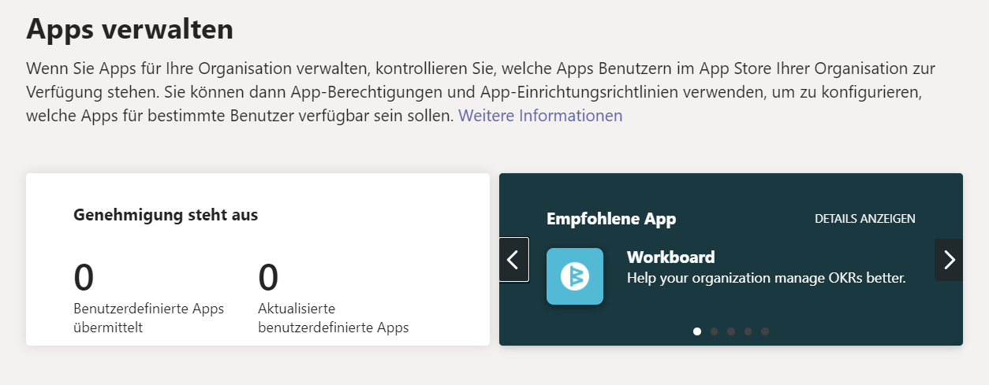
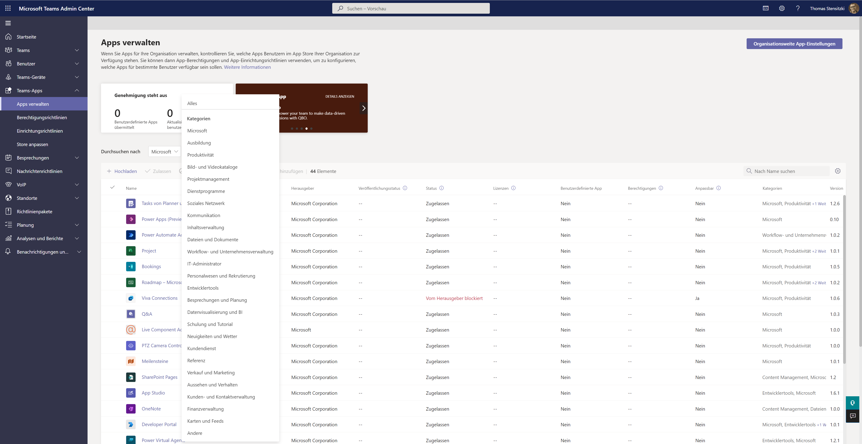
TAC: App lists and banners in the app management page

Slide 50
Neuigkeiten in Microsoft Teams für Admins
Sensitivity Labels for Teams Created from Templates
Information Barrier Open and Owner Moderated Modes in Teams Weitere Informationen
Cortana Voice Activation enabled by default in Teams Rooms Weitere Informationen
TAC: App lists and banners in the app management page
TAC: Enriching the App detailed page with more descriptive App information
Chat with users with Teams personal accounts

Slide 51
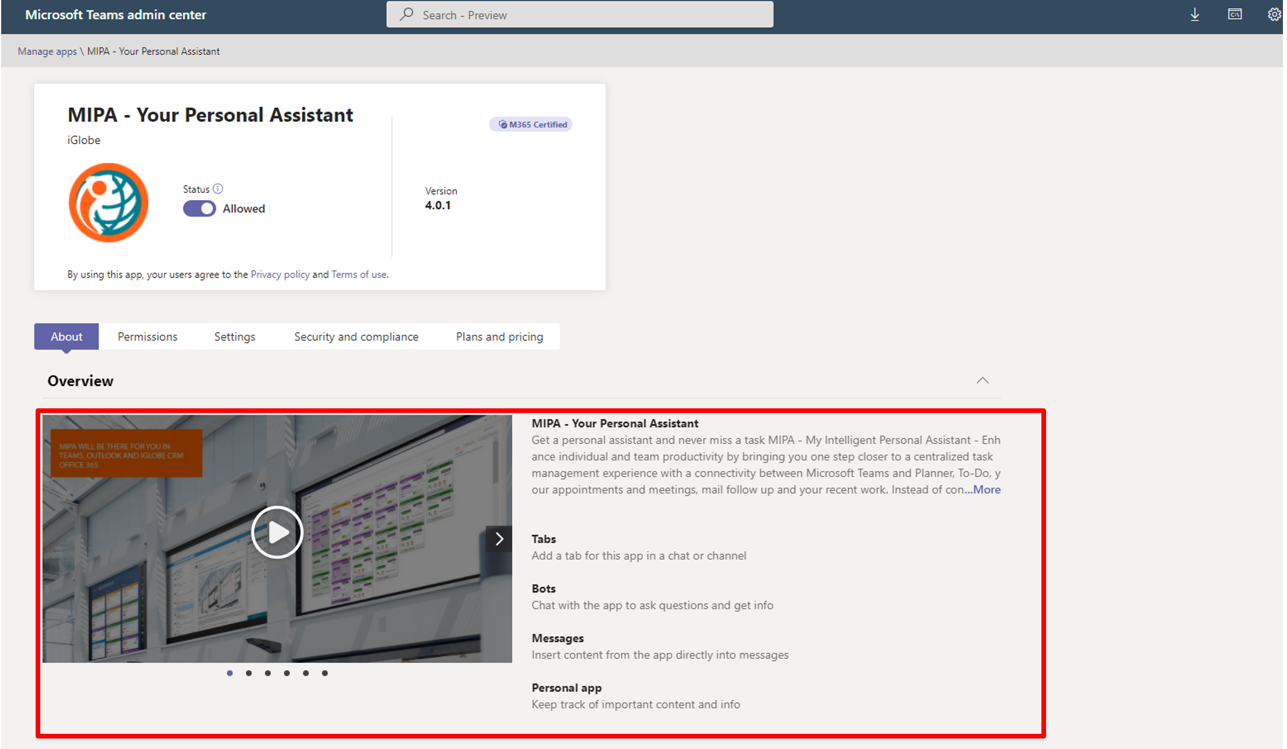
TAC: Enriching the App detailed page with more descriptive App information
Notes:
The feature will be phased roll out starting late January and will complete by late April.

Slide 52
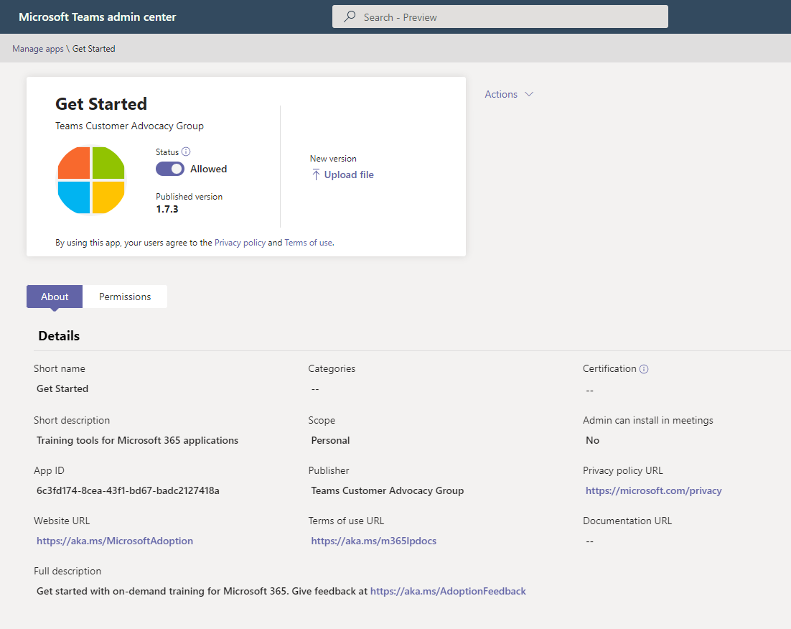
TAC: Enriching the App detailed page with more descriptive App information
Notes:
The feature will be phased roll out starting late January and will complete by late April.

Slide 53
Neuigkeiten in Microsoft Teams für Admins
Sensitivity Labels for Teams Created from Templates
Information Barrier Open and Owner Moderated Modes in Teams Weitere Informationen
Cortana Voice Activation enabled by default in Teams Rooms Weitere Informationen
TAC: App lists and banners in the app management page
TAC: Enriching the App detailed page with more descriptive App information
Chat with users with Teams personal accounts

Slide 54
Chat with users with Teams personal accounts
Automatisch aktiviert
Opt-Out
Tenant Level → CsTenantFederationConfiguration AllowTeamsConsumer AllowTeamsConsumerInbound
User Level → CsExternalAccessPolicy EnableTeamsConsumerAccess EnableTeamsConsumerInbound
Notes:
Timing: begin roll out in early December and expect to complete in mid-January (previously mid-December)

Slide 55
Was ist neu in Teams – Der Blog
What’s New in Microsoft Teams - December 2021
What’s New in Microsoft Teams - January 2022
Microsoft Teams Blog
Microsoft Teams Community Blog
Microsoft Teams Feedback Portal

Slide 56
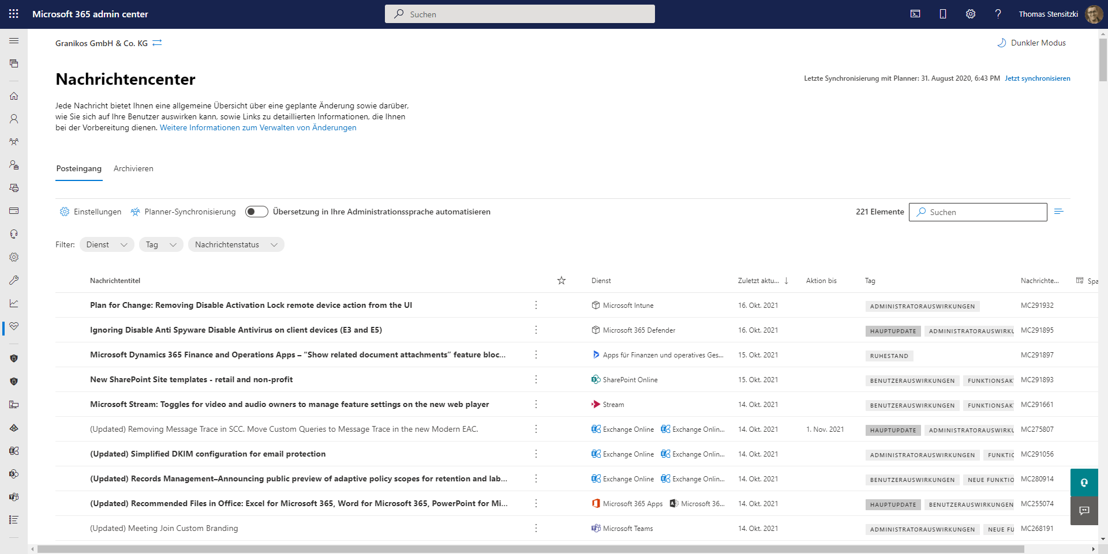
https://admin.microsoft.com/#/MessageCenter

Slide 57
Titel
Speaker @twitter

Slide 58
Organisatorisches

Slide 59
Veranstaltungen
Datum
23. März 2022 | Teams Nation
28. April 2022 | Teams User Group Berlin #18
19. Mai 2022 | aMS Berlin 2022
10./11. Juni 2022 | Scottish Summit 2022
26.-28. September 2022 | European Cloud Summit

Slide 60
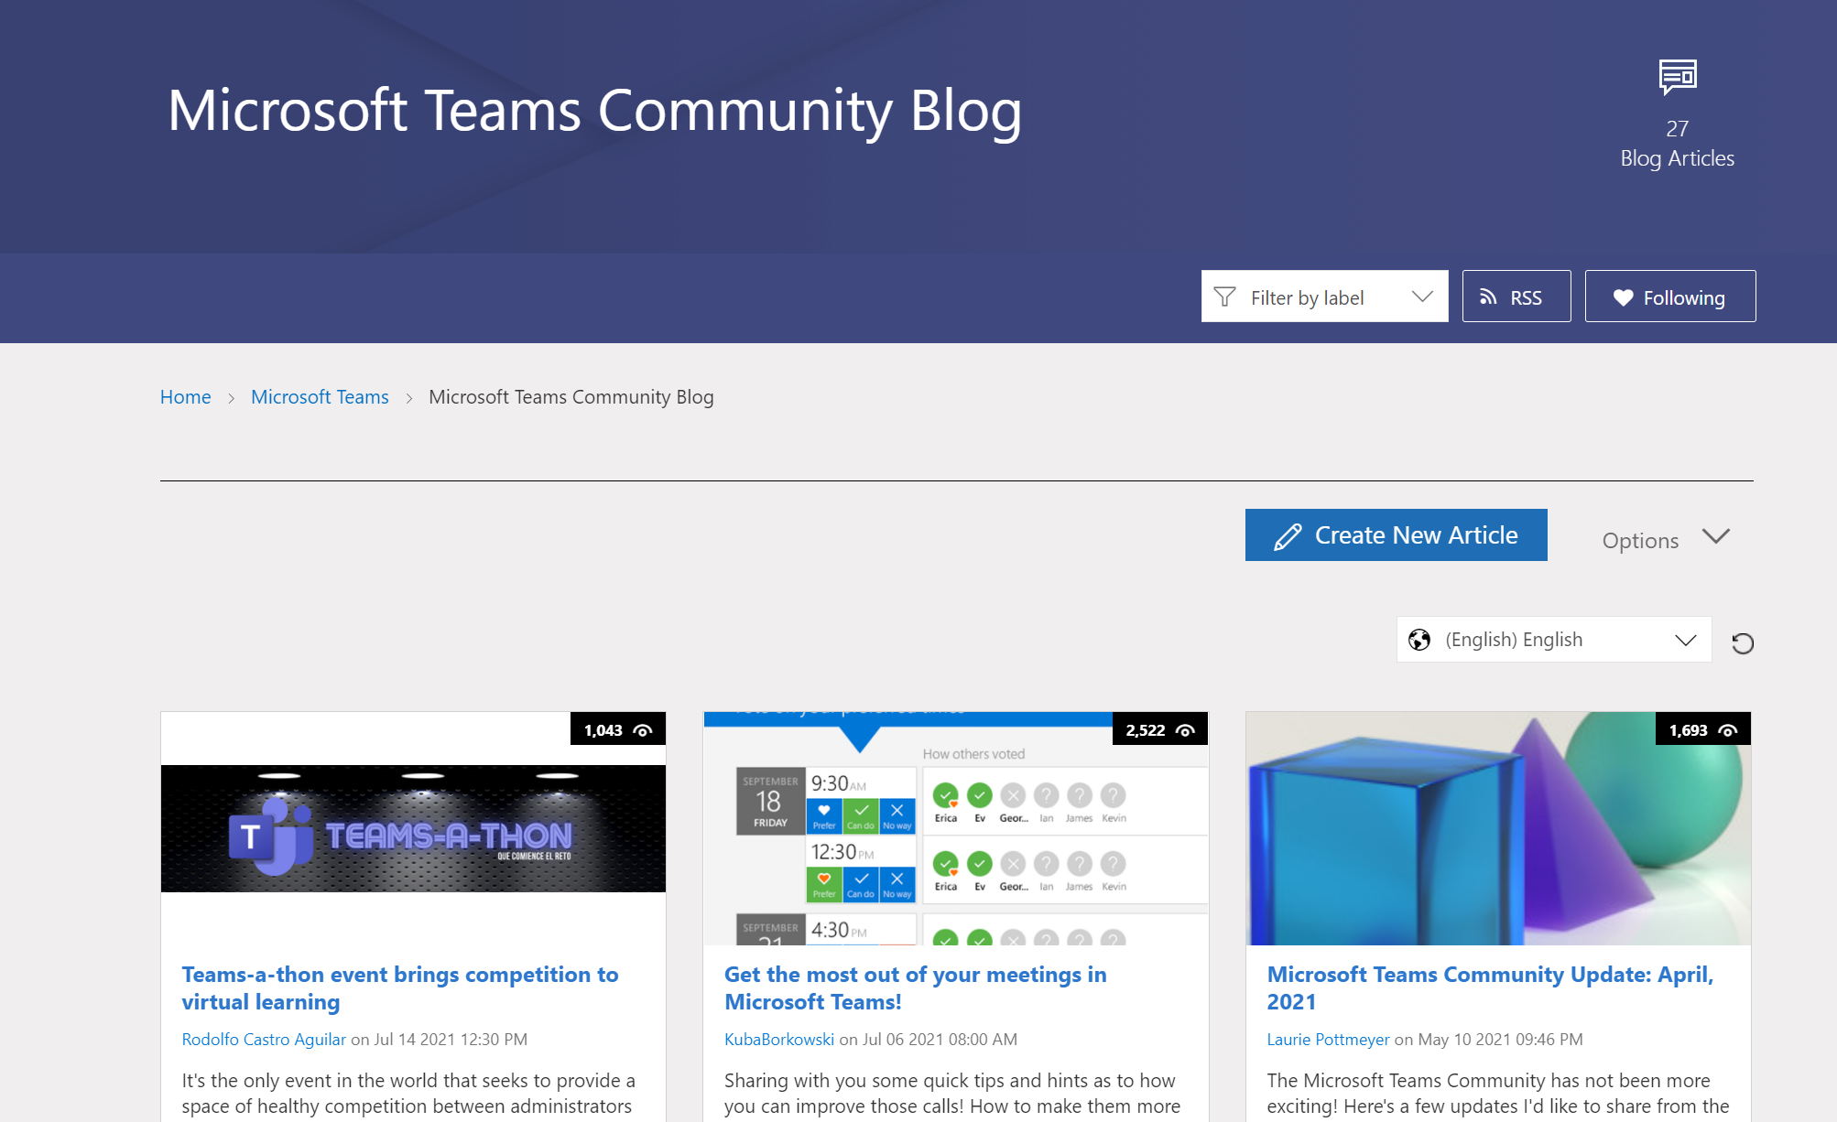
Teams Community Blog
→https://aka.ms/TeamsCommunityBlogger

Slide 61
Organisatorisches
Microsoft Community Tenant für User Groups
Teilnahme als Microsoft 365 Gast
Anmeldung: https://go.granikos.eu/TeamsUGForm
Einheitlicher Teams Meeting Teilnahme-Link
https://teamsusergroup.berlin/meetup

Slide 62
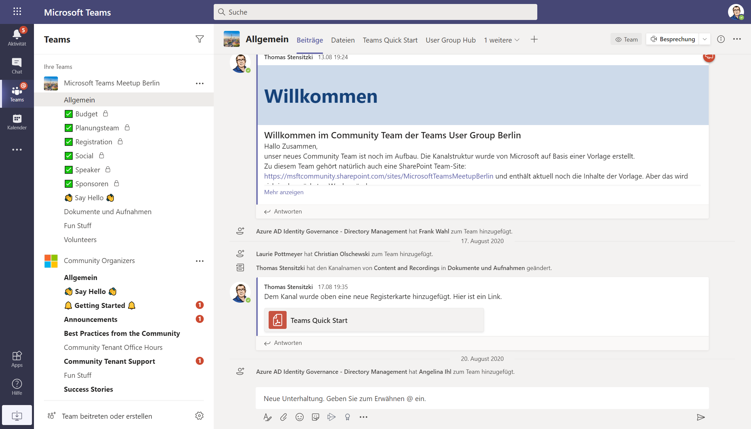

Slide 63
Vielen Dank für eure Teilnahme!
Das nächste Meetup:
→ 28. April 2022
https://TeamsUserGroup.Berlin/register
Spread the Word!
#TeamsUGBerlin
Aufzeichnungen unserer Meetups sind im Community Team und bei YouTube verfügbar.

Slide 64
Offene Diskussion

